Slide 1

Morphology and Word Formation in Natural Languages
DSA0304-Natural Language Processing
PRESENTED BY:
M. Rohith(192424054)

Slide 2


What is Morphology?
Morphology is the study of the internal structure of words.
It breaks words into the smallest meaningful units called morphemes.
It helps explain how words are formed and how their meanings change.
Example
Cat → Single morpheme
Cats → Cat + -s (plural suffix)
Unhappy → un- + happy

Slide 3
Morphemes and Word Structure
Types of Morphemes
1. Stem (Root)
Main part of the word that carries meaning.
Examples:
play
happy
teach
2. Affixes
Added to the stem to modify meaning.
Types of Affixes
Prefix: before the stem (unhappy)
Suffix: after the stem (cats, teacher)
Infix: inside the word (rare in English)
Circumfix: around the word (common in some languages)
Examples
Cats = Cat + -s
Unbuckle = un- + buckle

Slide 4
Types of Morphology
1. Inflectional Morphology
Adds grammatical information.
Does not change the word class.
Used for:
Plurals
Tense
Possession
Examples
Cat → Cats
Play → Played
Walk → Walking
2. Derivational Morphology
Forms a new word.
May change the part of speech.
Examples
Teach → Teacher
Happy → Happiness
Computerize → Computerization

Slide 5
Word Structure Processing in NLP
Why Morphology is Important in NLP
Natural Language Processing (NLP) uses morphology to understand different forms of words.
Morphological Processing
Breaking words into morphemes
Identifying stems and affixes
Recognizing prefixes and suffixes
Examples
Playing → Play + ing
Replayed → Re + Play + ed
Unhappy → Un + Happy

Slide 6
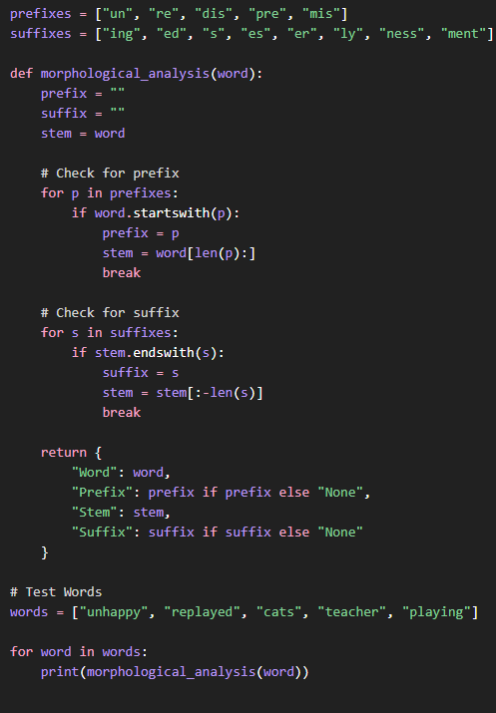
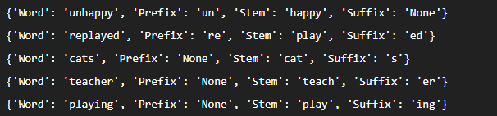
Implementation
Output

Slide 7
Thank You

